Slide 1




^{Notebooks 101 for SQL People}
^{Julie Koesmarno}
^{@MsSQLGirl} ^{MsSQLGirl.com}
^{Powered By}
^{#LightUp}

Slide 2


^{Donate}

Slide 3





^{Sponsors}
^{Powered By}

Slide 4
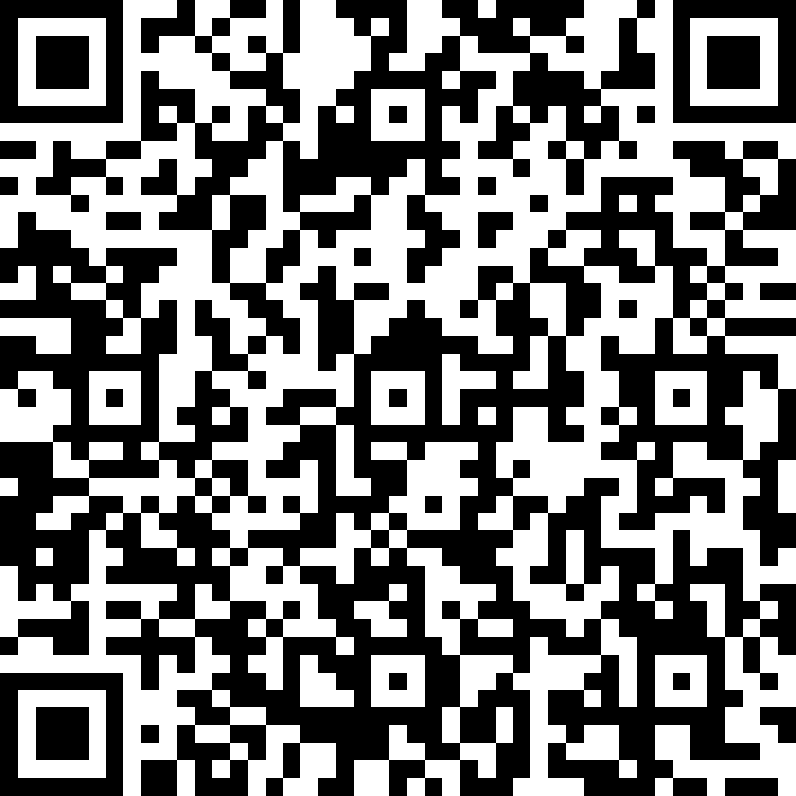
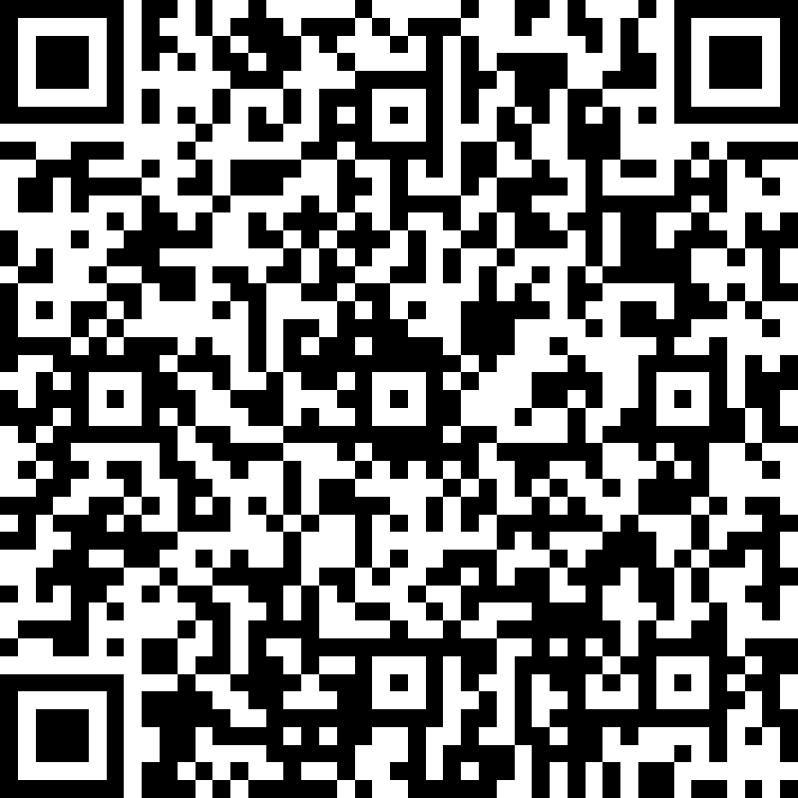
^{Feedback}
^{Speaker Feedback}
^{Event Feedback}

Slide 5

Notebooks 101
1. Why Notebooks?
2. Azure Data Studio ♥ Notebooks
3. aka.ms/AzureDataStudio

Slide 6
1
Why Notebooks?

Slide 7


--
-- Prepared by Cookie Monster
-- 2020.03.01
-- Question from Marketing about how much we sell and what's the shorter manufacturing time.
--
SELECT TOP 10 *
FROM Production.Product
ORDER BY Name ASC;
I need to know which product has the fastest turnaround ..
Let me query that!
Here you go…
Oh.. I need the product category..
-- Get Product list and product category with fast manufacture days
USE AdventureWorks2017;
GO
SELECT
c.Name AS ProductCategory
, p.Name as ProductName
, p.ProductNumber
, p.ListPrice AS Price
, p.DaysToManufacture
FROM Production.Product p
INNER JOIN Production.ProductSubcategory s
ON s.ProductSubcategoryID = p.ProductSubcategoryID
INNER JOIN Production.ProductCategory c
ON c.ProductCategoryID = s.ProductCategoryID
WHERE p.DaysToManufacture < 4
GO
-- Get Product List with fast manufacture days.
SELECT
p.Name as ProductName
, p.ProductNumber
, p.ListPrice AS Price
, p.DaysToManufacture
FROM Production.Product p
WHERE p.DaysToManufacture < 4
GO
Sure..
Here you go again…
1
Thanks! This is for the last quarter, right?
Do you mean sold products?
2

Slide 8
-- Get Product list and product category with fast manufacture days
USE AdventureWorks2017;
GO
SELECT
c.Name AS ProductCategory
, p.Name as ProductName
, p.ProductNumber
, p.ListPrice AS Price
, p.DaysToManufacture
FROM Production.Product p
INNER JOIN Production.ProductSubcategory s
ON s.ProductSubcategoryID = p.ProductSubcategoryID
INNER JOIN Production.ProductCategory c
ON c.ProductCategoryID = s.ProductCategoryID
WHERE p.DaysToManufacture < 4
AND EXISTS (SELECT TOP 1 1
FROM Sales.SalesOrderDetail sod
INNER JOIN Sales.SalesOrderHeader soh
ON soh.SalesOrderID = sod.SalesOrderID
WHERE sod.ProductID = p.ProductID
AND soh.OrderDate BETWEEN '20140101' AND '20140331')
GO
I need to know which product has the fastest turnaround ..
Let me query that!
Here you go…
3
Oh.. I need the product category..
Sure..
Here you go again…
Thanks! This is for the last quarter, right?
Do you mean sold products?
Here you go again…
You are a Rockstar! Thanks.

Slide 9
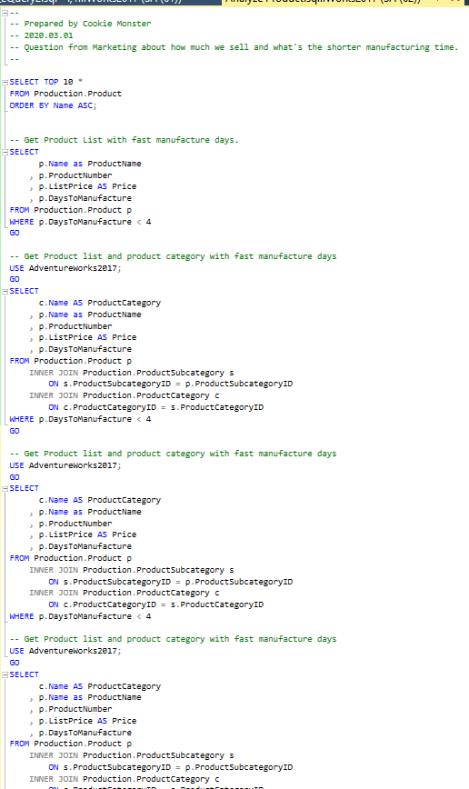
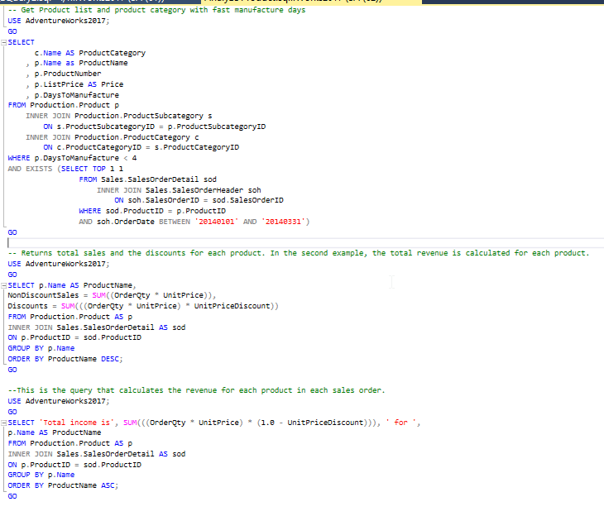
My dirty little scripts in the closet ….

Slide 10
28 DAYS LATER …

Slide 11
You know that list that you sent me last time about that fast manufacturer… Can refresh it, please?
PANIC
PANIC
PANIC
What list?
PANIC
Oh.. That list! Yea yea…
Here you go again…
PANIC
I want to compare what the result back then and what it is now; if we have had any changes…
PANIC
PANIC
Was the logic the same as what you did last time?
PANIC
Hello?
PANIC

Slide 12

What’s the problem?

Slide 13
Reproducibility
Code Review
Auditing results / analysis
Context
Executable
Code
Documentation
Results
Visualization
Analysis + Interpretation
Executable

Slide 14
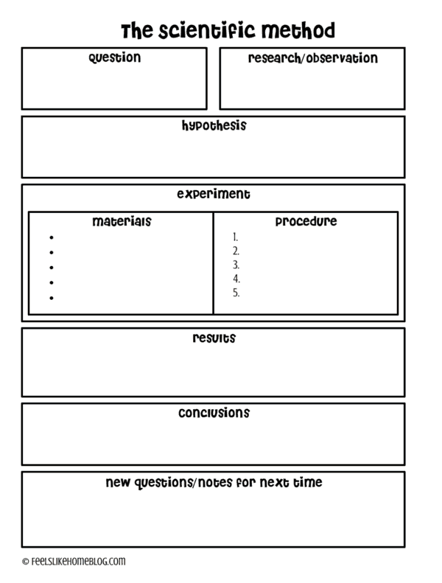

Remember School Science Project?
Source: https://feelslikehomeblog.com/2017/07/the-science-of-slime-its-way-more-than-polymers/

Slide 15


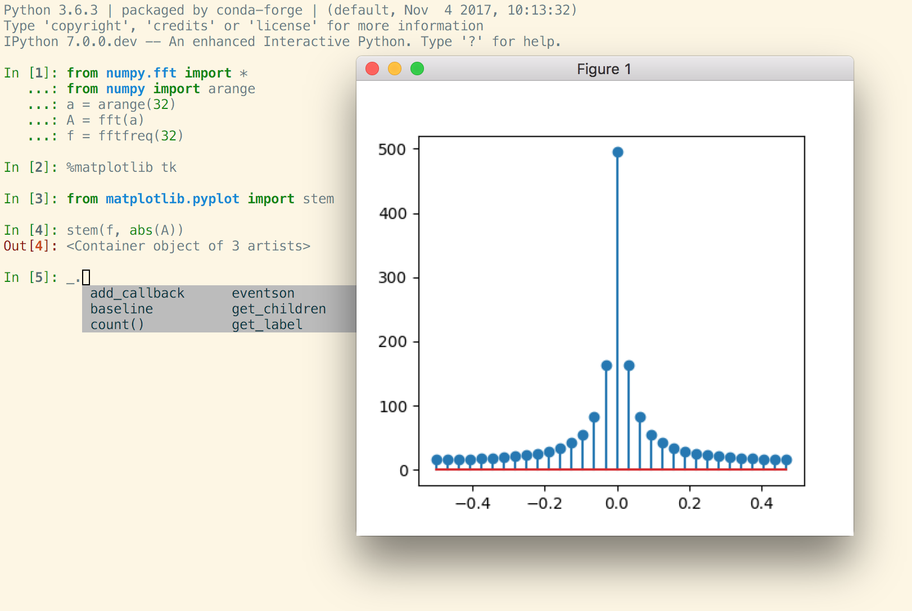

Mostly for Data Science projects
Open Source, open-standards and services for interactive computing for multiple languages – formed in 2015
Command shell for interactive computing – since 2001
Azure Databricks
Azure Notebooks*
VSCode
Azure Data Studio introduced notebooks in 2018 for Data professionals; and specifically for SQL People since 2019
Notebooks Journey

Slide 16
2
Notebooks in Azure Data Studio
Notes:
Predict properties of new data by learning from a sample
Predict sales of stores in a region based on historical sales
Predict probability of fraud on a new credit card transaction
Predict default of a new loan based on loan / transaction history
Predict sentiment of a new tweet or review
Classify new image(s) based on sample images & attributes
Classify data into groups or clusters
Popular ML technologies
R & Python

Slide 17
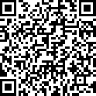
3
aka.ms/AzureDataStudio
Sample files: https://bit.ly/2YGTpAy

Slide 18
Other useful links
SQL Assessment API notebook
https://github.com/microsoft/sql-server-samples/tree/master/samples/manage/sql-assessment-api/notebooks
Glenn Berry’s Diagnostic Notebooks for SQL Server and Azure SQL DB:
https://glennsqlperformance.com/resources/
Rob Sewell’s Notebook
http://sqldbawithabeard.com
Sample notebooks: https://github.com/SQLDBAWithABeard/JupyterNotebooks
The SQL Diagnostic (Jupyter) Book by Emanuele Meazzo
https://tsql.tech/the-sql-diagnostic-jupyter-book/

Slide 19
Questions?
Julie Koesmarno
@MsSQLGirl
jukoesma@microsoft.com

